Slide 1
17-612 Fall 2023
Business & Marketing Strategy
Class 6
Jim Berardone
Associate Professor of the Practice of Product Management

Slide 2
A note about selecting your Target Markets
Remember: Your company’s strategy and product line strategy has markets served in its “scope.”
As a result, they have:
existing customer relationships
brand awareness
Aligning your target markets with these can be more beneficial for your product’s success and provide a more persuasive business case.

Slide 3
Today’s class
Direct Competition
Indirect Competition
Selecting and Describing the Competition
Positioning

Slide 4
What are the implications of Competition on the work of Product Managers, Engineers and Designers?

Slide 5
The most successful products have a strong, highly differentiated position in the market versus their competition.

Slide 6

I’ve asked many entrepreneurs: “Who are your competitors?”
We don’t have any competitors!
Nobody has anything like our product!
Our product is better!

Slide 7
Direct Competition

Slide 8
Recall from Class 4 and Product Assignment 2
 | Question | Your answer should be…
Product Name | What is the product’s name? | A temporary or trademarkable identifier.
Type of Product | What kind of product is it? | A category the product would belong to.
Main Function(s) | What will be product do? | The main activity(s) it will do.
Product Attributes | What are the its characteristics? | The key features and traits
Competitive Differentiator | What is the key product attribute that provides the most unique benefit? | The unique feature and benefit
Key Technology | What “technology” will be “inside”? | The key internal parts of the product.
Product Complements | What other products does the customer need for this product to work? | The platform, systems, and/or services.
Visual | What will it look like? | A ‘sketch’ of the product or a key part of it.
How it Works | How will it be used by the user? | Concisely describe how the product will work from the user’s perspective.

Slide 9

“Type of product” is is known as a Product Category
A classification of products and services that are similar in purpose, functionality, form or format.
Makes it easier for customers to find and refer to products.
Examples:
- Smartphone
- Notetaking apps
- Table lamps
The products in the category are known as
“Direct Competitors”
Image Source: https://www.androidauthority.com/best-camera-phone-test-mid-2021-1648623/

Slide 10

An established product category has:
multiple products from multiple producers (vendors)
a label (‘name’)
a size
Total no. units sold per year
Total revenue per year
growth rates
annual Year-Over-Year (YOY)
past, present, future
a life cycle stage
Product category: smartphones
Image Source: https://www.androidauthority.com/best-camera-phone-test-mid-2021-1648623/

Slide 11
Example Product Category → Smartphones
Includes these products and many more:
Samsung Galaxy S23 Ultra
Apple iPhone 14 Pro
Google Pixel 7 Pro
Samsung Galaxy Z Fold 5
Samsung Galaxy Z Flip 5
Apple iPhone SE
Samsung Galaxy A14 5G
Motorola Moto G Power
Wiko View2
OnePlus Nord
Alcatel A3
Apple iPhone 12

Slide 12
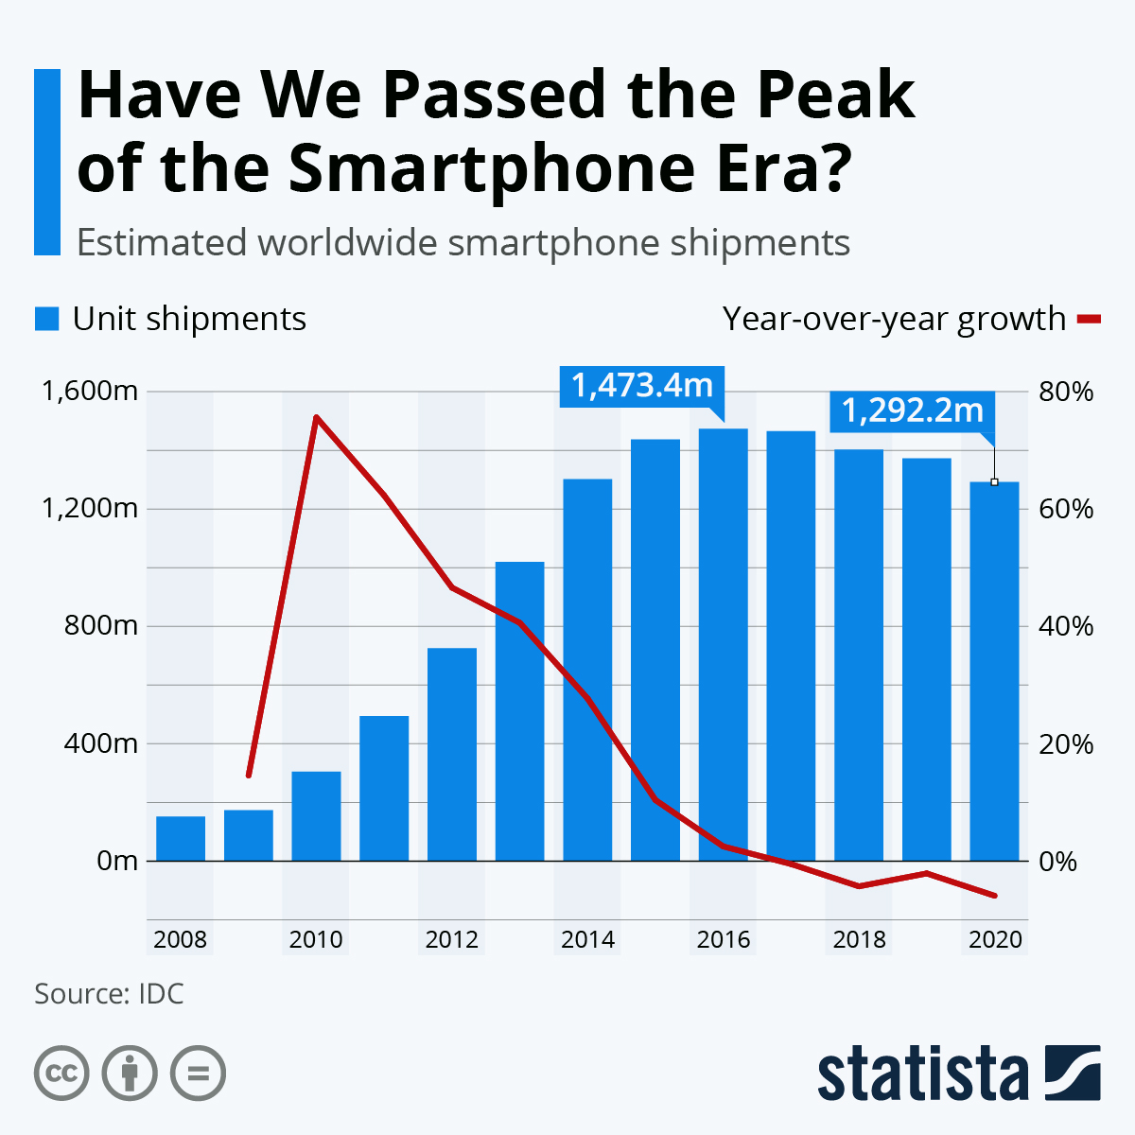
Example: Product Category → Smartphones
Units Sold
1.29 B units shipped in 2020
--> $410 B (USD)
YOY Growth rate is negative
-2% from 2019 to 2020
Since 2018, units sold per year is declining
Image source: Statista.com Data source: IDC.com

Slide 13
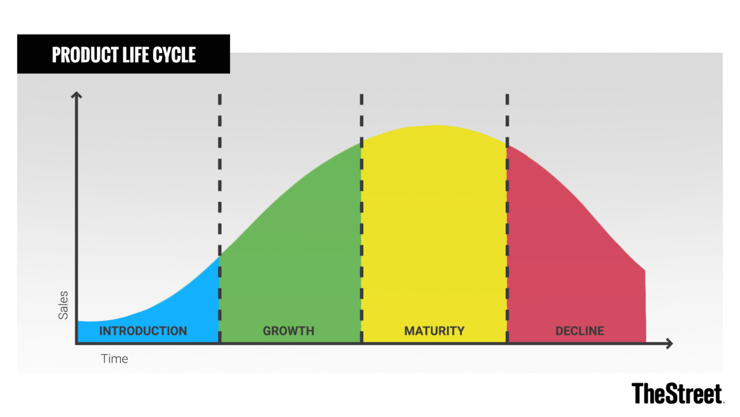
The Smartphones category is in the maturity stage of the Product Life Cycle. (and approaching the decline stage.)
Illustration Source: www.thestreet.com

Slide 14
The Product Category data tells you:
There is customer demand for products like this → willing to pay.
How much demand there has been.
The trend in customer demand.
The stage of a product category’s life.
→ This info leads to different marketing-mix decisions.

Slide 15
For your Product Assignment No. 3
Identify a Product Category for your idea
Identify the products that are likely the most noteworthy in the category (e.g., market leaders, disruptors)
The Life Cycle stage of the product category (in your best judgment)
(optional) Total sales of that category’s products
Units (sold, shipped, downloaded) or sales revenue (USD ($) or other currency)
the most recent year(s) that you can find
(optional) Growth rate of the product category sales
growth of units or sales revenue (USD ($) or other currency)
most recent year(s) that you can find

Slide 16
Where to find the label of your product category? Look for sites that have a product taxonomy
Shopping
sites
Amazon.com
App Stores
Walmart.com
Staples
Warning:
Their categories may not be specific enough.
Product Review sites
Yelp
Capterra
G2 Crowd
TripAdvisor
Warning:
Their categories may not be specific enough.
Industry Analysis firms
Gartner (B2B)
Frost & Sullivan
Available on Course Library page
Forrester Research (B2B)
IDC

Slide 17
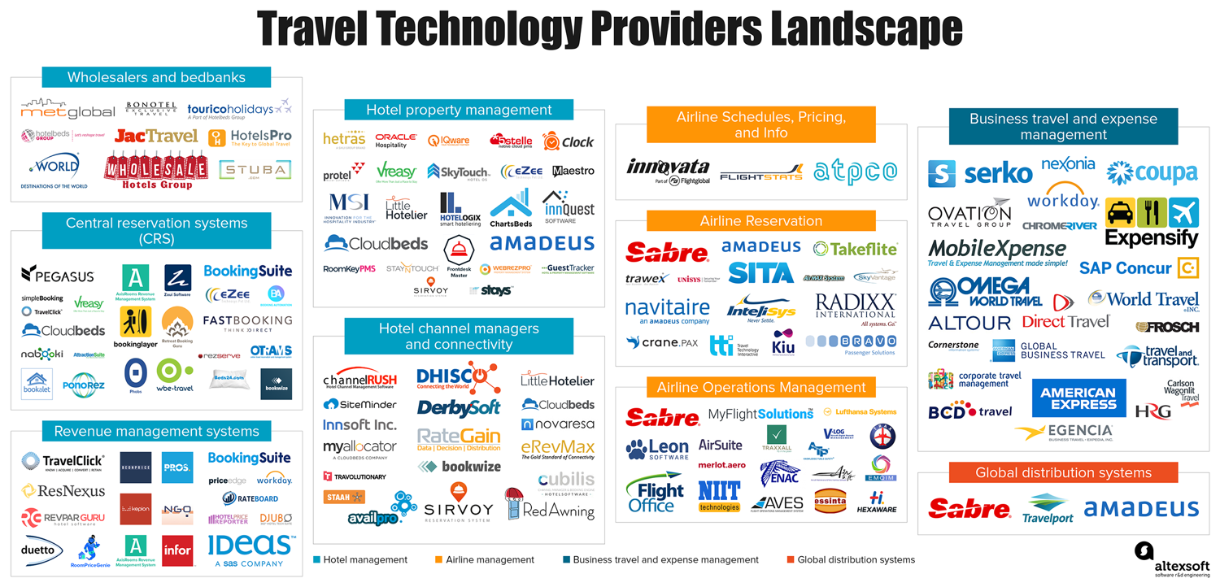
TIP: Search for a “Market Landscape” or “Market Map” like this:
Image source: https://www.altexsoft.com/infographics/travel-technology-providers-landscape/

Slide 18
Product Categories often have one or more levels of categories. Select the one that is best fit.
Enterprise Management Software
Supply Chain Management
Customer Relationship Management
Enterprise Resource Planning
Product Lifecycle Management
Human Capital Management
Payroll and Benefits Management
Recruiting and Staffing
Talent Management
Learning and Development
Workforce Management
Applicant Tracking Systems
Candidate Relationship Management
Top level product category
”product category” refers to any level.

Slide 19
Where to find a product category’s sales and growth?
Statista.com can be very useful – a collection of market statistics (and others.)
Premium content is available from the CMU Library Database (not the Course Library page)
Go to CMU Libraries page: https://www.library.cmu.edu/
Login with your CMU credentials
Select “Databases A-Z” from the menu at the top.
On the “All Database Types” menu, select “Data and Statistics.”
Choose “Statista” (or another relevant source)

Slide 20
Exercise
Identify the product category for your product idea as established by others.
Identify some of your direct competitors
company + product name
3. Try to find:
sales per year
growth rate per year
Use the Statista site via the CMU Libraries page

Slide 21
Indirect Competition

Slide 22
Indirect competition
The other options customers can choose to satisfy the same purpose as your product category.
a.k.a. “product substitutes”
The other options can be:
other product categories and the products and services in them
“manual” ways

Slide 23
Example: Identifying the customer’s options
Sedans
Nissan Maxima
SUVs
Toyota Camry
Buses
Ford Fusion
Trains
Chevy Malibu
User
Office Worker
purpose
“To get
to work”
Motorcycles
Honda Accord
Bicycles
Hyundai
Genesis
Walk
Purpose is the task the user is trying to do while using your product. a.k.a. Job To Be Done (JTBD)

Slide 24
Direct and Indirect Competition
Products in other Product Categories are your INDIRECT competitors
Products in your Product Category are your DIRECT competitors
Nissan Altima
Sedans
Toyota Corolla
SUVs
Buses
Ford Fusion
User
Office Worker
Purpose
(JTBD)
“To get
to work”
Trains
Chevy Malibu
Motorcycles
Honda Accord
Bicycles
Chrysler
Sebring
Walk

Slide 25
If the customer’s purpose was changed
Delta Airlines Business Class
Personal
Vehicle
United Airlines Economy Class
Airline
User
Office Worker
Purpose
(JTBD)
“To visit
a customer”
Southwest Business Select
Private jet
Service
Shuttle
Service
American Airlines Flagship Business
Train
Service
JetBlue Airways Mint
Product Categories
Products

Slide 26
Selecting and Describing the Competition

Slide 27
Select the key competitors (2 – 3 for your project)
a.k.a. next best alternatives
The 2 – 3 options a customer has available that you want to give most of your attention. Use your judgment.
A market leader
A challenger (“2nd or 3rd place)
An innovator
The key competitors could be:
all direct competitors
all indirect competitors
a mix.

Slide 28
Describe each competitor (2 – 3 for your project)
Company name
Product name (if a manual method, create your own label)
The key differentiator of that product (why do customers choose their product?)
The key markets they serve
Pricing, if you can find it

Slide 29
Positioning

Slide 30
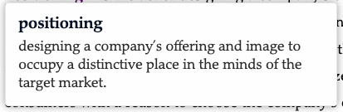
Definition: Positioning
Kotler, P., Keller, K.L. (2021). ”Marketing management” 16th edition (16th Global Ed.).

Slide 31




What comes to mind? What products do they offer?

Slide 32
When you think of their product(s), what characteristics come to mind?

Slide 33
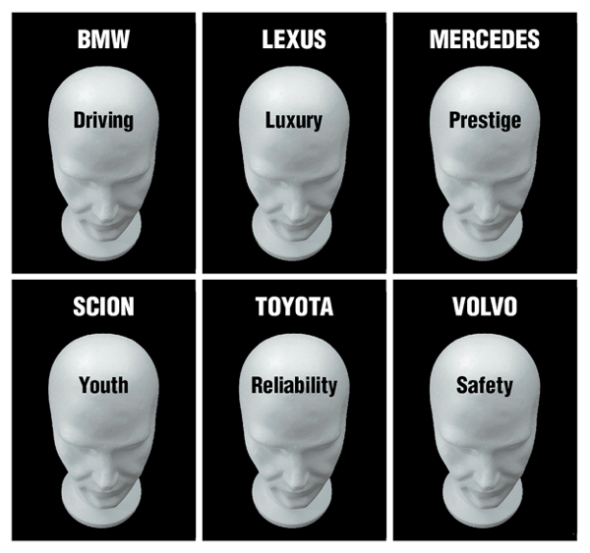
There’s a big advantage if positioning is done well. Your product will occupy a clear position in the minds of customers.
Automobiles
it’s easier to sell/buy
it creates more customer benefits
it leads to higher customer loyalty
Image source: www.brandengineers.com

Slide 34
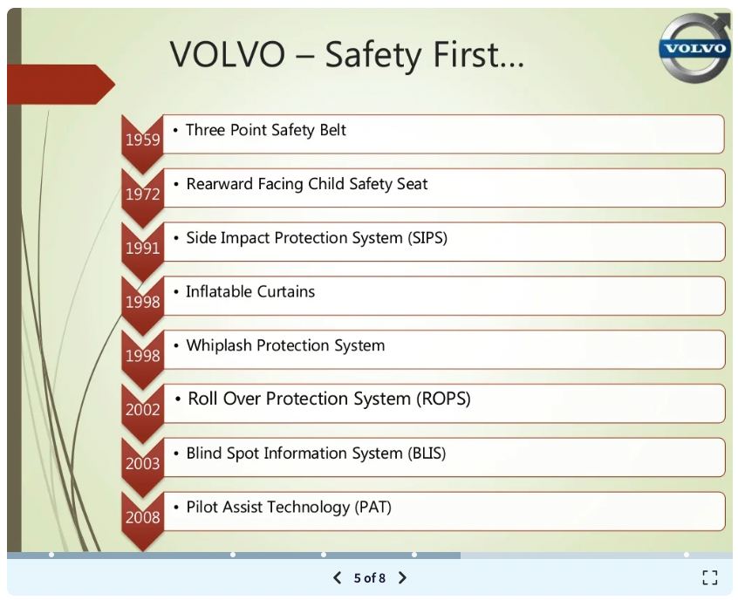
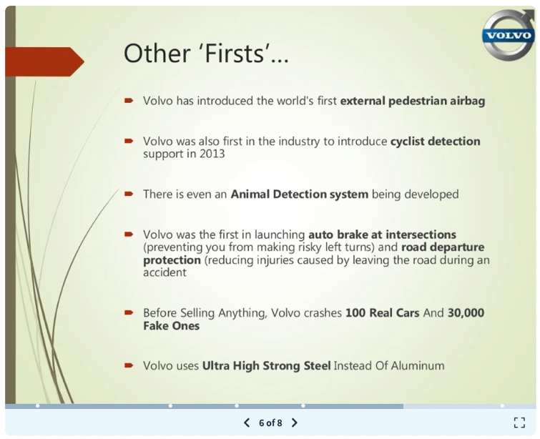
Volvo’s product decisions reinforce their desired positioning as the “safest vehicles”
Images source: https://www.slideshare.net/RohanBharaj/brand-positioning-statement-of-volvo (Sep 29, 2016)

Slide 35



“Prospects don’t buy, they choose."
Notes:
Your product needs to stand out. Not in trivial ways but on the the unique benefits it provides to customers.

Slide 36
“If you try to be everything to everyone, you’ll be nothing to no one.”

Slide 37
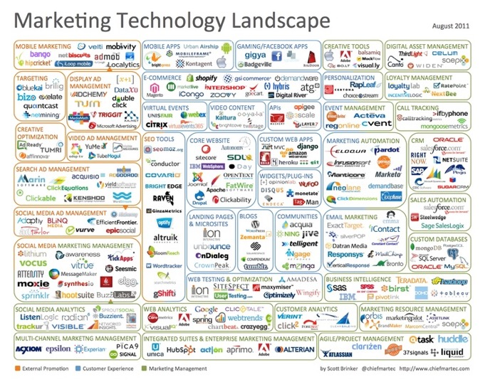
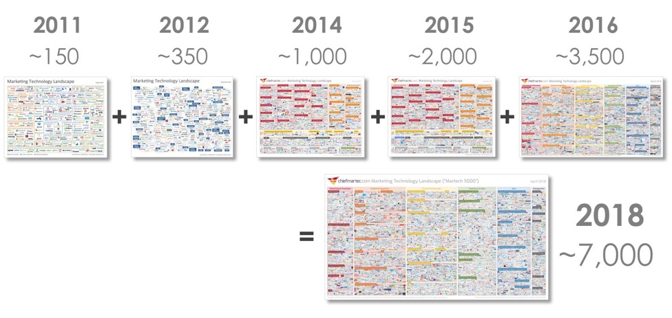
The importance of effective positioning increases over time.
Image source: https://chiefmartec.com/2018/04/marketing-technology-landscape-supergraphic-2018/

Slide 38
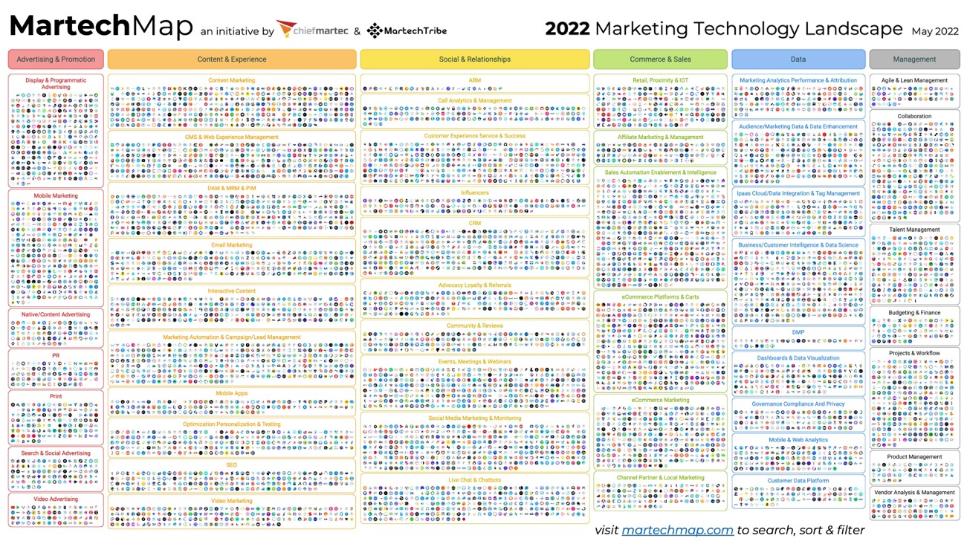

Slide 39
An intentional positioning strategy leads to strong product differentiators

Slide 40
It’s most important to take the customer’s perspective
The biggest mistake
Thinking like a vendor (seller of the product.)
You’ll be blind-sided.
Instead
Think from a customer’s perspective
-- to understand the choices that they believe they have
-- to know how they make decisions to buy and/or use a product
-- Every option that they consider IS a competitor
Consider
What task is the user trying to get done?

Slide 41
After you’ve identified the competitors:
Identify the criteria that the customers use to evaluate their options
Create a positioning map with the current competition (2 to 3)
Analyze the positioning map for potential position(s) to own with your product
Select the position(s) to own with your product.
Create a positioning map with the current competition and your product (2 to 3 + 1)
Explain the “position-to-own” and write a positioning tagline for that position.

Slide 42
1. Identify the criteria THE CUSTOMERS will use to evaluate an option to buy/use for their purpose
The criteria are the factors that customers use to evaluate products/services to purchase (or to use a free product.)
These criteria are important to the customer – they’re the basis for meaningful product positioning and differentiation.
a.k.a. Criteria = purchasing criteria = buying criteria = factors

Slide 43
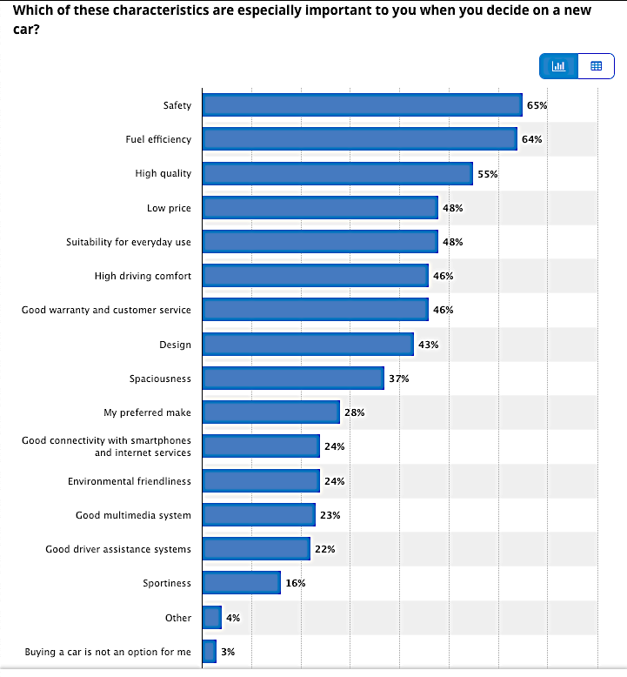
Example Criteria
Buying a new car
(USA consumers)
Source: www.statista.com
2018 Consumer survey results
Slightly modified for teaching purposes

Slide 44
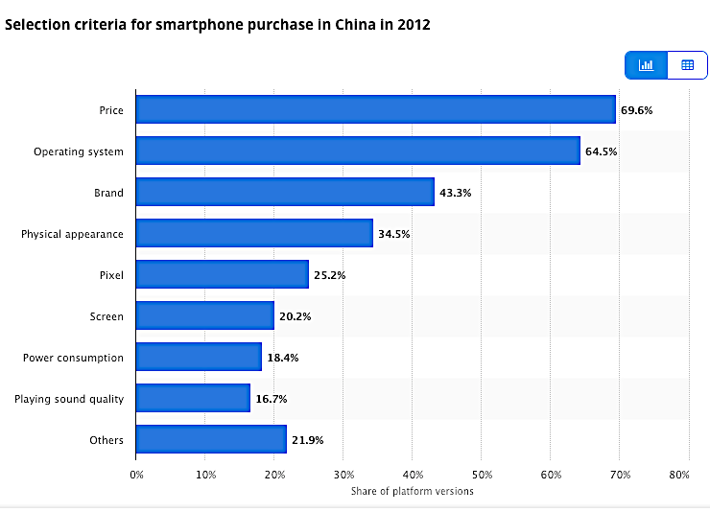
Another example of Criteria.
Smartphone purchases
(China consumers)
Source: www.statista.com.
2012 Consumer survey results

Slide 45





Discussion
Presumably,
you considered multiple degree programs and/or multiple universities before making your decision.
→ Identify all the criteria you used to evaluate the options

Slide 46
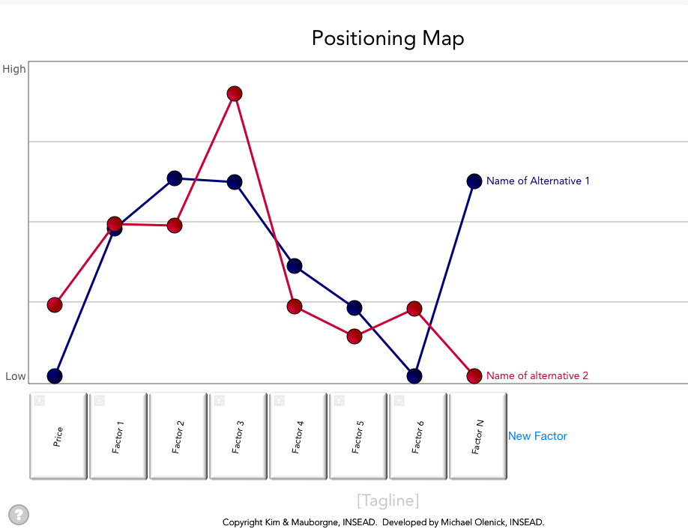
2. Create a positioning map with the current competition
Y-axis = ”low to high”
the relative “amount” the customer receives of each criterion.
(from the customer’s perspective!)
Plot the top competitors on each criterion
X-axis = criteria (a.k.a. factor)
Also known as a “Strategy Canvas,” a name coined by Renée Mauborgne and W. Chan Kim, authors of the Blue Ocean Strategy.

Slide 47
Example (former student): Software Deployment Tools

Slide 48
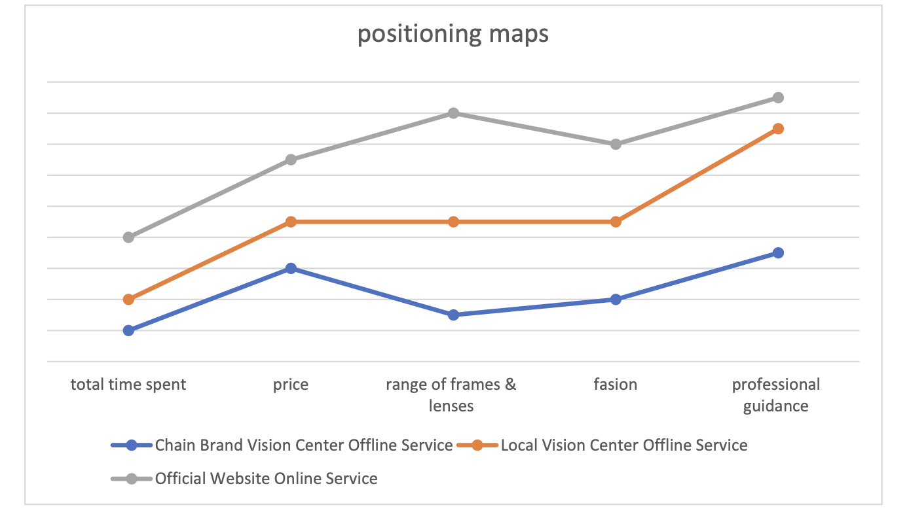
Example (former student): Eyeglass Selection

Slide 49
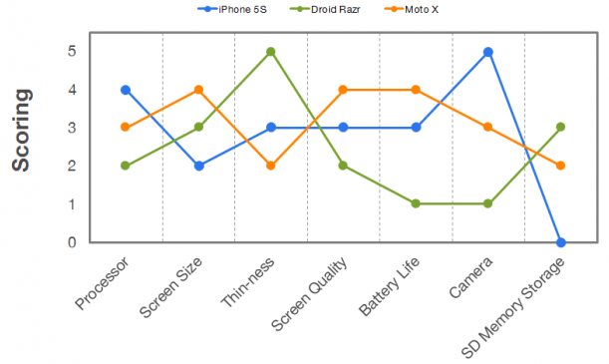
Example: smartphones (many years ago)
Image source: www.ignitionframeworks.com

Slide 50
How do you decide where to plot the competitors?
Options (in practice)
Use your judgment
Collective judgment of a small group who are familiar with the customers’ perspective
Survey a small sample of the target market
Mathematical + data collection techniques on larger populations
Conjoint analysis
Multivariate analysis (regression analysis, factor analysis, cluster analysis)
There is a Positioning Map template (MS Excel) posted on Canvas with the next assignment.

Slide 51
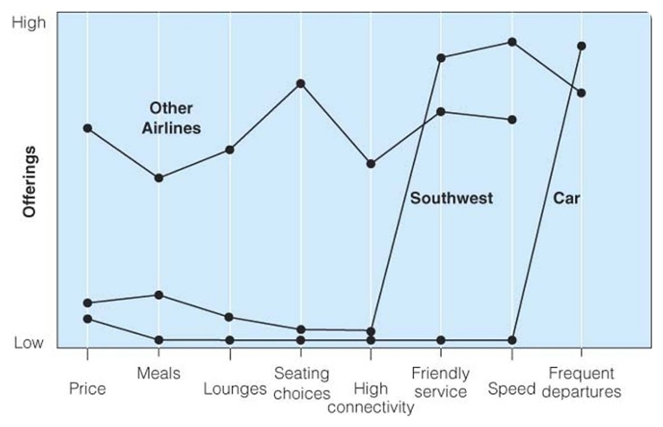
Y-axis: High does not mean “better” – it means the product offers “more” of that criterion
High means the customer receives more
Low means the customer receives less

Slide 52
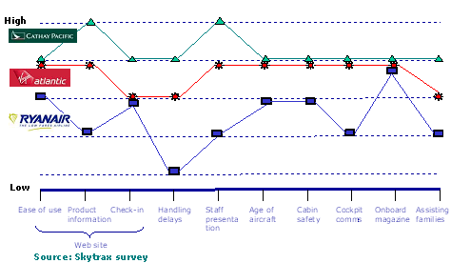
Example: airlines
Reference

Slide 53
Example: short-haul trips of 600-800 miles
Reference
Notice the mix of product categories (cars) and a specific product (Southwest Airlines)

Slide 54
3. Analyze the positioning map for potential position(s) to own with your product
First, determine: where are the “white spaces”?
The white spaces are the available positions in the market.
They are shown in green on this diagram!
Notes:
Create a positioning map with the current competition and your product (2 to 3 + 1)

Slide 55
4. Select the position(s) to own with your product.
Select the positions you want (and can) occupy in the minds of your customers.
These positions are your Differentiators
You do not need to be different on each criterion.
It can be costly to create each difference.
It might not be possible.
On this diagram, the white space are shown in green!
Notes:
Create a positioning map with the current competition and your product (2 to 3 + 1)

Slide 56
Southwest decided to differentiate on “friendly service” and ”speed” versus cars for short-haul trips of 600-800 miles
These 2 criteria became their ”differentiators”
You do NOT need to be different on every criteria to succeed!
Notes:
Short haul 600-800 miles

Slide 57
5. Create a positioning map with the current competition and your product
This map is now a projected “future state” when your product is introduced to the market.

Slide 58
Example (former student): Software Deployment Tools This map shows how she wanted to position her product idea called Starship, in the future state when it was released.

Slide 59
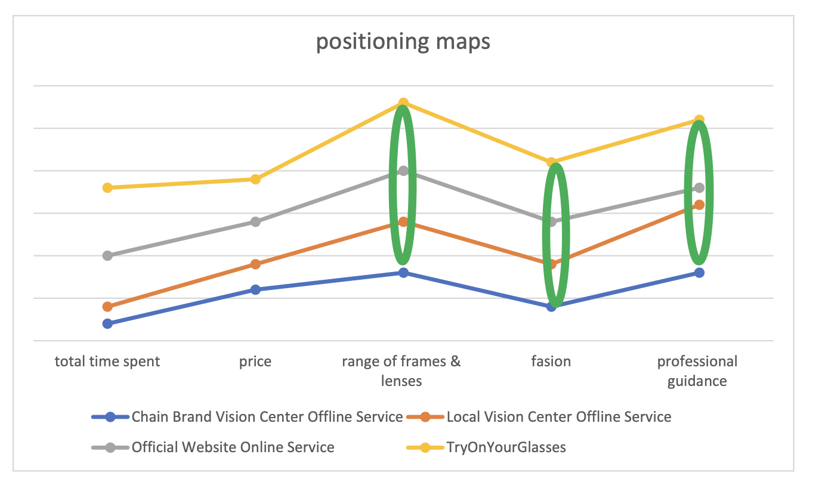
Example (former student): Eyeglasses Selection This maps shows how she wanted to position her product idea called “TryOnYourGlasses”, in the future state when her product is released.
She mistakenly plotted her “total time spent” as HIGH. Her product takes less time to select (which is better.)

Slide 60
6. Write a positioning tagline that captures your position to own
A simple statement that focuses on the key benefit or key feature to customers while differentiating from the top alternative (competitor.)
“Volvo. For Life.”
“UberX. Get an affordable ride, all to yourself.”
“Accounting software for Business Owners who dislike bookkeeping.
”One click and you get dozens of valuable metrics”

Slide 61
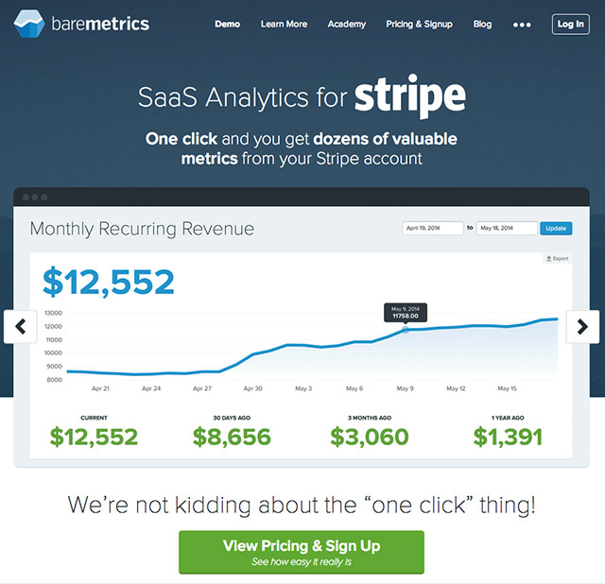
Positioning Tagline Example
Reference
Focused on the key feature
to customers
implicitly differentiates from the alternatives
“one-click”
source: https://ryanbattles.com/post/position-your-saas-product/

Slide 62
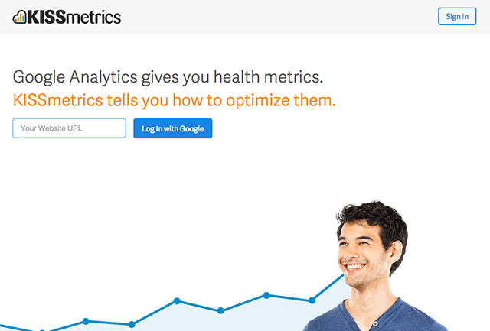
Positioning Tagline Example
Reference
Direct comparison with a competitor
source: https://ryanbattles.com/post/position-your-saas-product/

Slide 63
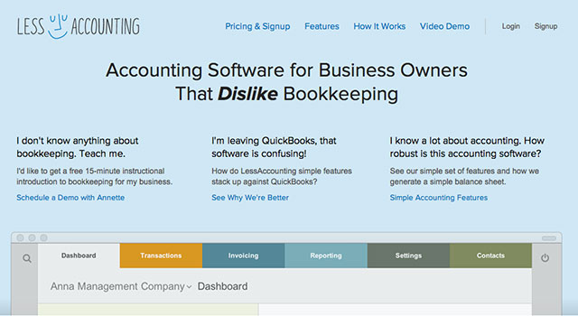
Positioning Tagline Example
Reference
Focused on the target users and their problem
source: https://ryanbattles.com/post/position-your-saas-product/

Slide 64
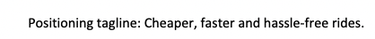
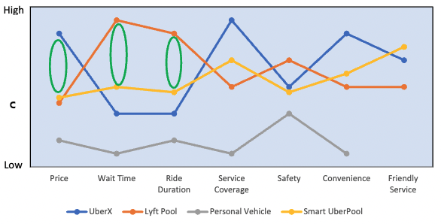
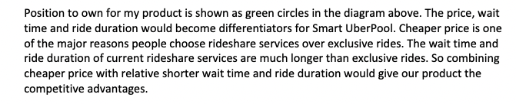
Example 1 (former student) Position to Own and Positioning Tagline.
Reference

Slide 65
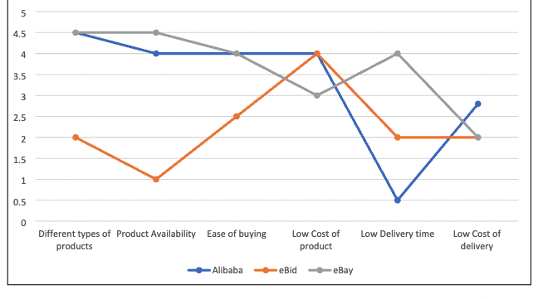
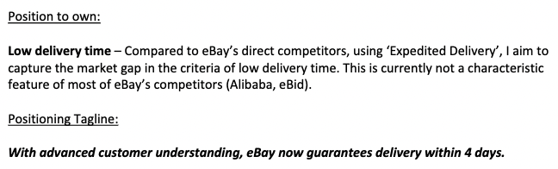
Example 2 (former student) Position to Own and Positioning Tagline
Reference

Slide 66
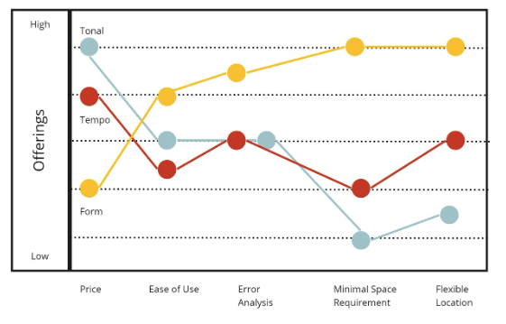
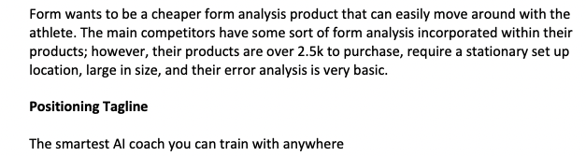
Example 3 (former student) Position to Own and Positioning Tagline
Reference

Slide 67
The End

